Slide 1
Numerical Differentiation Methods
Fish 559; Lecture 8
Notes:
a

Slide 2
Symbolic vs Numerical Differentiation
Differentiation is algorithmic - there is no function that cannot be differentiated (given patience and a large piece of paper).
Many packages (including R) include symbolic differentiation routines. These apply an algorithm to provide code which computes the derivatives analytically.
Numerical differentiation involves applying approximations to calculate the value of the derivative at a given point.

Slide 3
Symbolic differentiation in R-I
The function “D”, called as follows, does symbolic differentiation:
This is NOT a a very smart function:
my.deriv <- function(mathfunc, var) {
temp <- substitute(mathfunc)
name <- deparse(substitute(var))
D(temp, name)
}
> my.deriv(x*x^2,x)
x^2 + x * (2 * x)

Slide 4
Symbolic differentiation in R-II
D can, however, be quite useful:
However, D may crash for complicated formulae.
> my.deriv(x*(1-x)-a*x*v/(x+d),x)
(1 - x) - x - (a * v/(x + d) - a * x * v/(x + d)^2)
> my.deriv(x*(1-x)-a*x*v/(x+d),v)
- (a * x/(x + d))

Slide 5
The Deriv function-I
Numerical methods often require the derivatives of functions. R includes the function “deriv” which calculates gradients:
ff <- deriv(expression, name, function name)
For example:
This creates a function ff.
ff<-deriv(~x*(1-x)-a*x*v/(x+d),c("x","v"),
function(x,v,a,d) NULL, formal=T)

Slide 6
The Deriv function-II
function(x, v, a, d)
{
.expr1 <- 1 - x
.expr3 <- a * x
.expr4 <- .expr3 * v
.expr5 <- x + d
.value <- (x * .expr1) - (.expr4/.expr5)
.grad <- array(0, c(length(.value), 2), list(NULL, c("x", "v")))
.grad[, "x"] <- (.expr1 - x) - (((a * v)/.expr5) - (.expr4/(.expr5^2)))
.grad[, "v"] <- - (.expr3/.expr5)
attr(.value, "gradient") <- .grad
.value
}

Slide 7
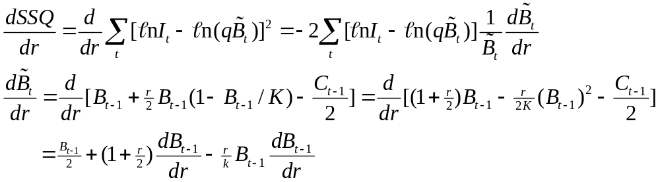
Calculating Derivatives Numerically-I
Sometimes calculating derivatives analytically can get rather tedious. For example, for the dynamic Schaefer model:
I think you get the picture…

Slide 8
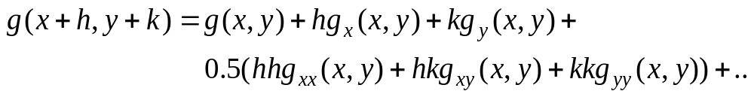
Calculating Derivatives Numerically-II
Methods of numerical differentiation rely on Taylor series’ approximations to functions, i.e.:

Slide 9
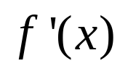
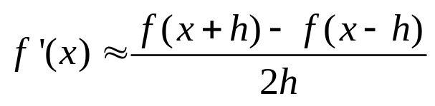
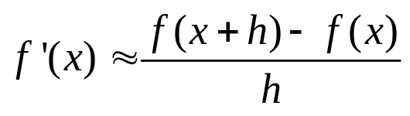
Calculating Derivatives Numerically-III
Two common approximations to exist. Both rely on two function evaluations – which is to be preferred?
We can compare them in terms of how well they mimic the Taylor series expansion of f

Slide 10
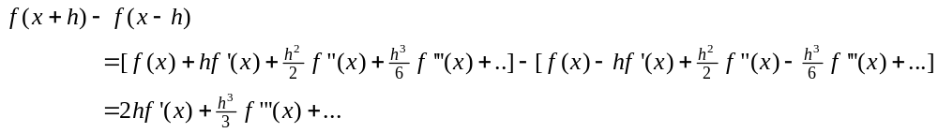
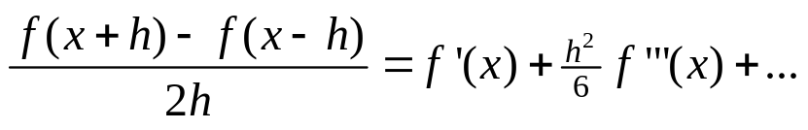
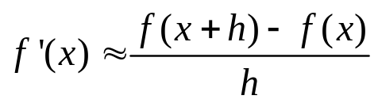
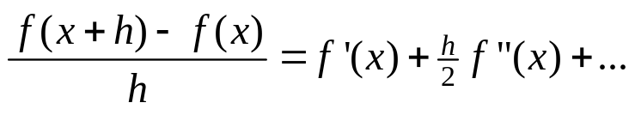
Calculating Derivatives Numerically-IV
Therefore:
Applying the same approach to leads to:
The “central difference” approach is therefore clearly preferable
if “h is small”.

Slide 11
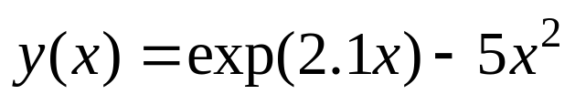
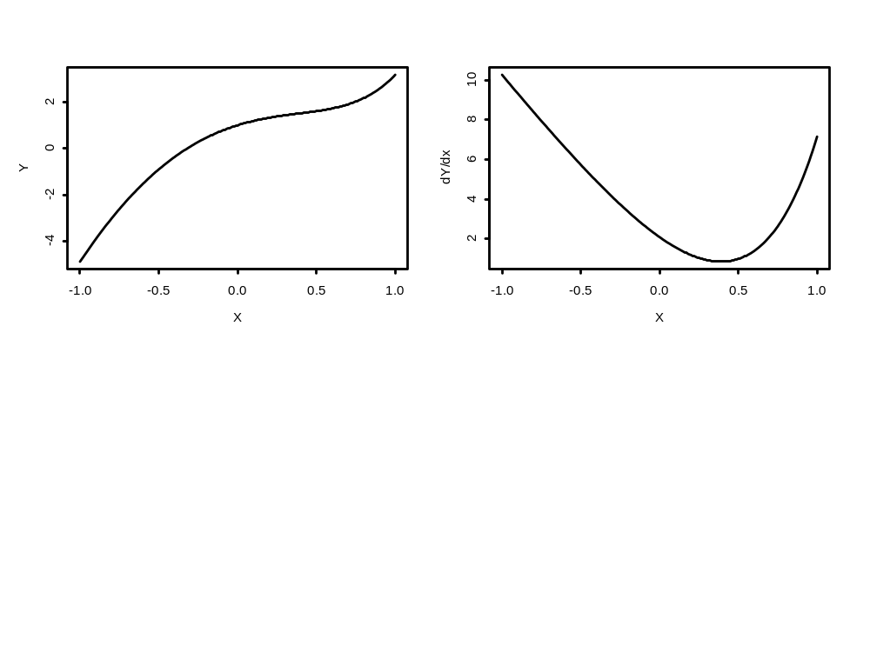
Does the Previous Result Hold up in Reality-I?
Derivative at x=0.5 (h=0.0001)
True: 1.001067
Central difference: 1.001067
Right difference: 1.001198

Slide 12
Does the Previous Result Hold up in Reality-II?
Derivative at x=0.5 (h=h <- 0.0000000000000001)
True: 1.001067
Central difference: 2.220446
Right difference: 4.440892
So what happened?

Slide 13
Calculating Derivatives Numerically-V
When I need an accurate approximation to a derivative, I have tended to use the four-point “central difference” approximation.
Central differences perform badly when calculating derivatives on a boundary.

Slide 14
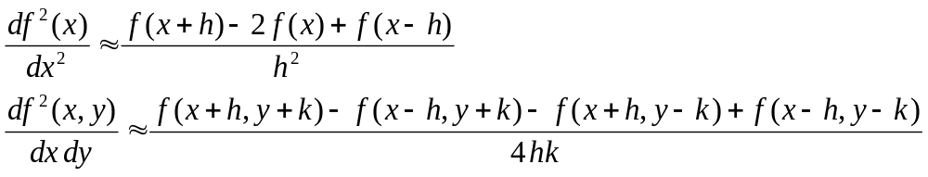
Calculating Derivatives Numerically
The accuracy of the approximation depends on the number of terms and the size of h / k (smaller – but not too small – is better)

